Slide 1
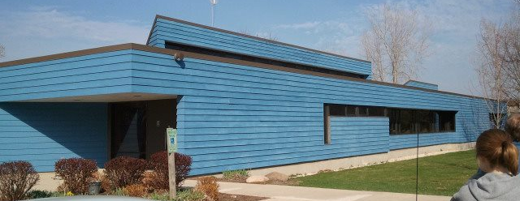
Mauthe Center Solar Project
NWTC
Solar Advanced System Design Class

Slide 2
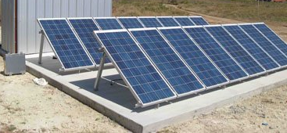
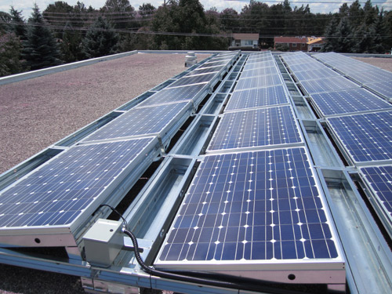
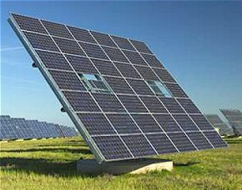
Possible Mounting Options
Flat roof
Portrait
Landscape
Pole Mount
With Tracking
With Out Tracking

Slide 3
Possible Array Locations

Slide 4
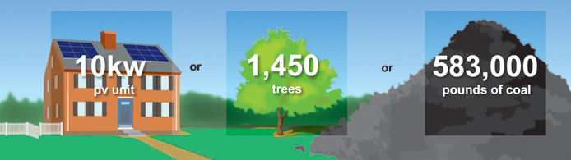
Energy Consumption
Annual electrical consumption: 63,000 kWh/ yr
To completely offset consumption a 52 kW system would be needed
Estimated cost for a 52 kW system (roof mount): $210,000 - $300,000*
Estimated cost for a 52 kW system (pole mount): $312,000 - $410,000*
* cost may vary depending on actual infrastructure requirements

Slide 5
Your Budget
An approximate 6 KW ballasted roof mount PV system would be in line with your $30,000 budget.
This PV system would offset a little over 10% of your present electrical consumption.
A 6 KW PV system would meet the electrical needs for a conservative household. (8 KW would be for the typical household)
A 6 KW PV system would produce approximately 7200 KWH/ year.

Slide 6
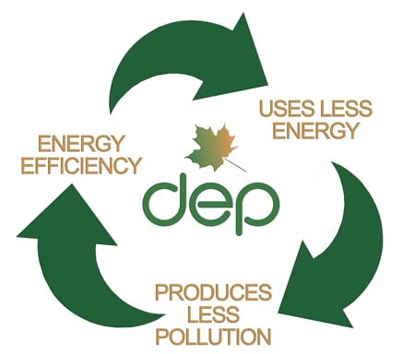
Energy Efficiency
Concentrate on energy efficient methods
Ex. Turn off lights, close doors, sectional heating/cooling, occupancy sensors, use natural lighting, power strips, etc.
Replace inefficient components of building
Ex. Furnace, air supply, lighting, windows, insulation, etc.

Slide 7
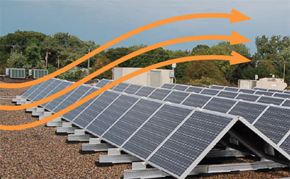
Flat Roof Design
6 kW system
Ballasted Racking = No moving parts & easy to maintain
Landscape modules to minimize wind load
Minimal shading for maximum production
Estimated annual production: 7,200 kWh/ yr
Estimated cost: $24,000 - $36,000

Slide 8
Pole Mount Front of Building
3kW
Minimal shading to maximize output
Increased cost of pole mount = less solar modules
Great visibility/ public awareness
Estimated annual production: 3,600 kWh/ yr
Estimated cost: $18,000 - $24,000

Slide 9
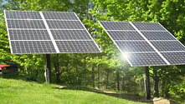
Pole Mount Behind Building (exceeds budget)
6kW
Minimal shading to maximize output
Tucked away/ less visible
Estimated annual production: 7,200 kWh/ yr
Estimated cost: $36,000 - $48,000

Slide 10
SOLAR ENERGY
PROVIDING A BRIGHT FUTURE
ENVIRONMENTALLY SOUND ENERGY
DISTRIBUTED ENERGY BENEFITS / LOCAL JOBS / LOCAL ENERGY / KEEPS OUR ENERGY DOLLARS IN OUR COMMUNITY.
OFFSETTING FOSSIL FUEL CONSUMPTION
SIMPLE / RELIABLE / DURABLE / LONG LIFE

